Slide 1
ParallelSpaces: Visualization of Weighted Bipartite Graphs

Slide 2
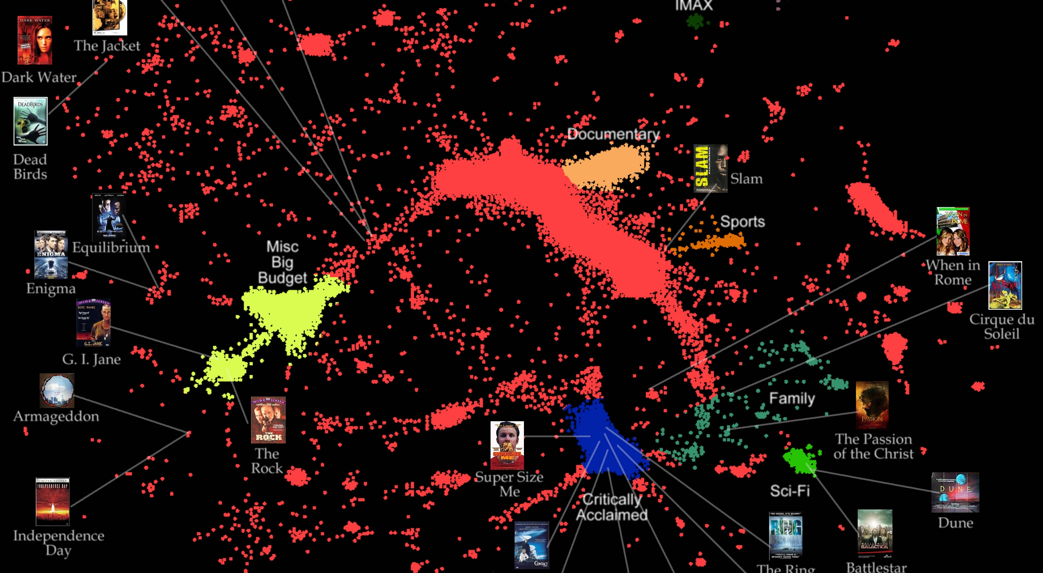
Motivation

Slide 3
 | Item 1 | Item 2 | Item 3 | Item 4 | Item 5
User A |  | 1 | 1 | 4 | 4
User B | 4 |  | 3 | 3 | 5
User C |  | 5 |  | 1
User D | 2 |  | 5 |  | 1
User E | 3 | 3 | 2 | 2 | 4
1
2
5
3
4

Slide 4
 | Item 1 | Item 2 | Item 3 | Item 4 | Item 5
User A |  | 1 | 1 |  | 4
User B | 4 | 2 | 3 | 3 | 5
User C | 1 |  |  | 1
User D | 2 | 4 |  | 1 | 1
User E | 3 | 3 | 2 |  | 4
1
2
A
D
5
3
C
4
B
E

Slide 5
Demonstration

